Slide 1


[Social Buzz- Data Analysis]

Slide 2


Agenda
Project recap
Problem
The Analytics team
Process
Insights
Summary

Slide 3

Social Buzz was the content creature platform in Social media, Over 500 million people have signed up for the Social Buzz platform
over the past five years .
To handle the data and trends of the social Buzz growth, Accenture has created a team to focus on :
- A review of their big data practice
- Advice for a successful initial public offering
- - An examination of their content categories that focuses on the top five categories with the highest aggregate popularity .
Project Recap

Slide 4

Problems Social Buzz faces:
Every day, users load tons of data, making it difficult to keep track of and organize it.
Each day, more than 10000 pieces of data are stored.
Analyses to determine the top five categories of content for Social Buzz.
Problem

Slide 5



Andrew Fleming
Chief Technical Architect
The Analytics team
Marcus Rampton
Senior Principle
Shakin Amarthiya Pandian
Data Analyst

Slide 6
Process
1
Data Understanding
2
Data Cleaning
3
Data Modelling
4
Data Analysis
5
Insight Data

Slide 7

Insights
January/May
16
1897
UNIQUE CATEGORY
MOST CONTRIBUTED MONTH
HIGHEST REACTED CATEGORY

Slide 8
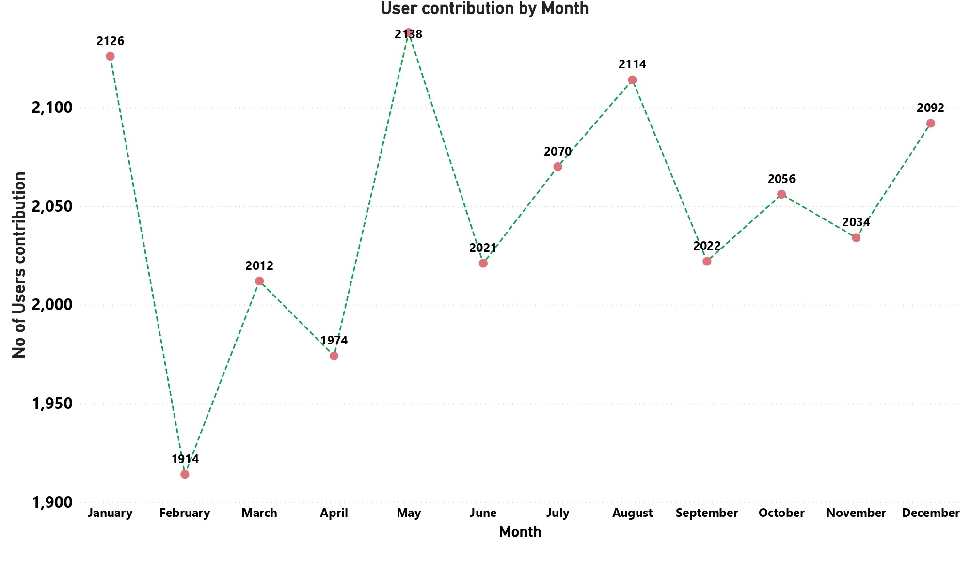

Slide 9
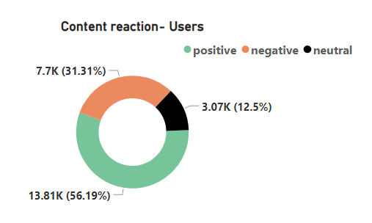
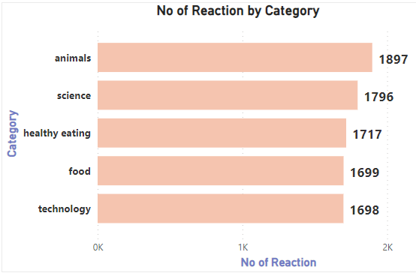

Slide 10

This analysis shows that the most popular category of content on the Social Buzz platform was Animals, followed by Science.
According to the analysis, the majority of users are active in May; therefore, if additional content in the months between May and December, such as topics related to animals, science, and healthy eating, aid in gaining additional users
Summary

Slide 11
Thank you!
ANY QUESTIONS?

